Slide 1

Diocese of Grafton
Church Attendance returns
2019-2023

Slide 2
> Annual returns
Since 2020 – collection of more descriptive church attendance data

Slide 3

Sources
Annual Returns of the Diocese of Grafton 2019-2023
Some 2023 Returns have not been lodged so dataset is incomplete
Census material: Census Anglicans in Australia, Colin Reilley 2022 and @AustralianAnglican Twitter Account

Slide 4
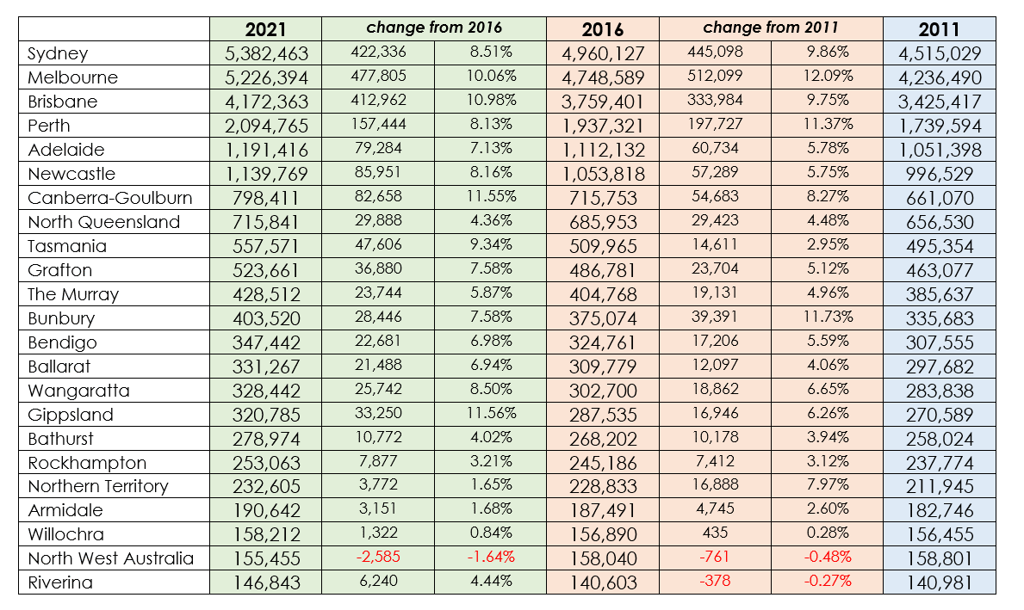

Slide 5
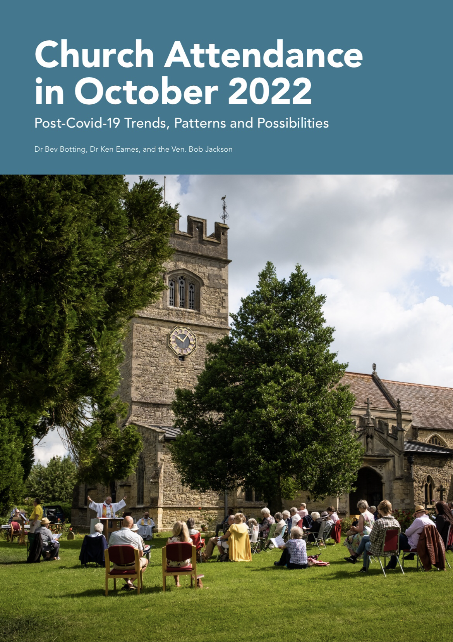

Slide 6
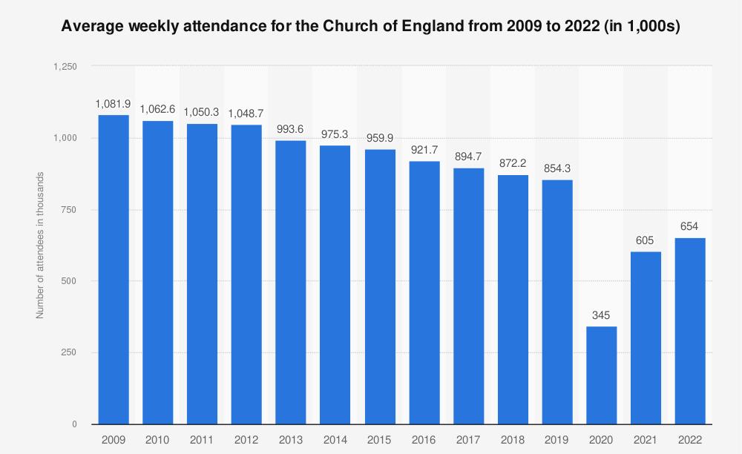


Slide 7
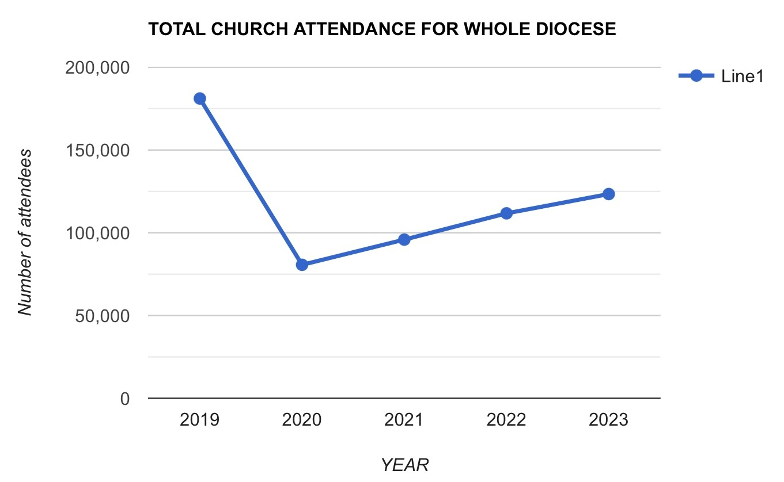
Total Church Attendance in Grafton Diocese each year 2019-2023
Includes attendance at all services of worship in the parish.
Attendance at School services is only included if held on a Sunday eg Lindisfarne & SCAS Chapels.
2019: 181,121
2020: 80,644
2021: 95,869
2022: 111,737
2023: 123,393
This figure in the Annual Returns form does not include online attendance.

Slide 8
Since 2020 - more descriptive data in the Annual Returns
Average Sunday Attendance
Average Weekday Attendance
Attendance at outcentres Weekly, Fortnightly, Monthly
Online Participation
Easter and Christmas Attendance trends
Numbers of Baptisms, Weddings, Funerals
Number of Admissions to Holy Communion, Receptions and Confirmations

Slide 9
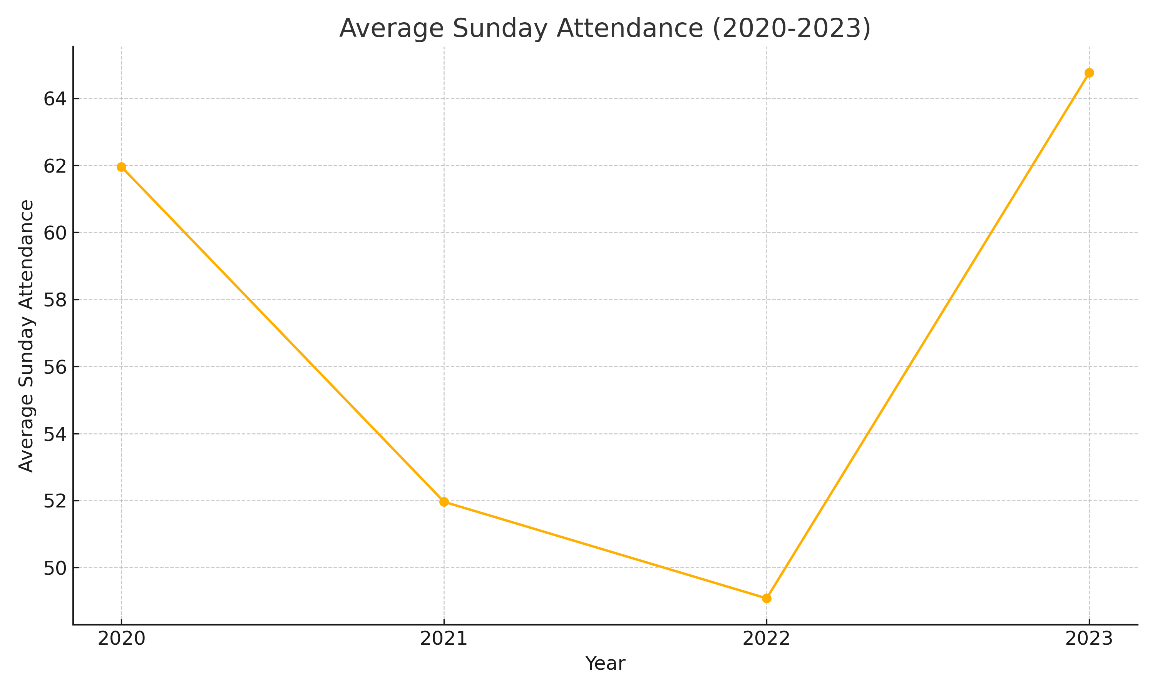
Includes attendance for the whole Ministry Unit but only if it is held every Sunday.
Average Sunday Attendance has only been reported since 2020
Missing data for 2 parishes

Slide 10
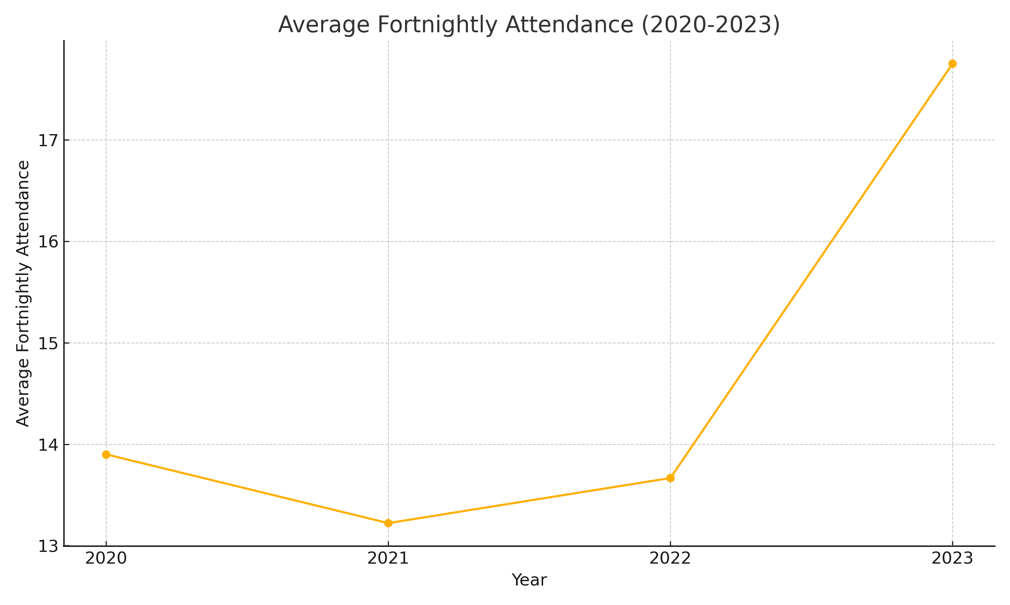
Attendance at worship centres where there is only a service once a fortnight.
Missing data for 2 parishes.

Slide 11
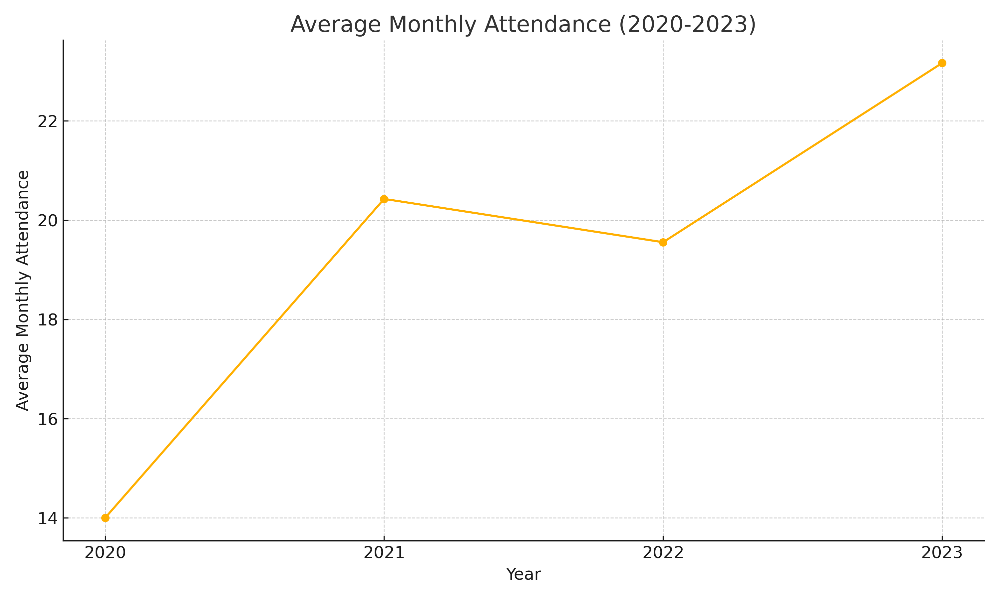
Attendance at worship centres where there is only a service once a month.
Missing data for 2 parishes.

Slide 12
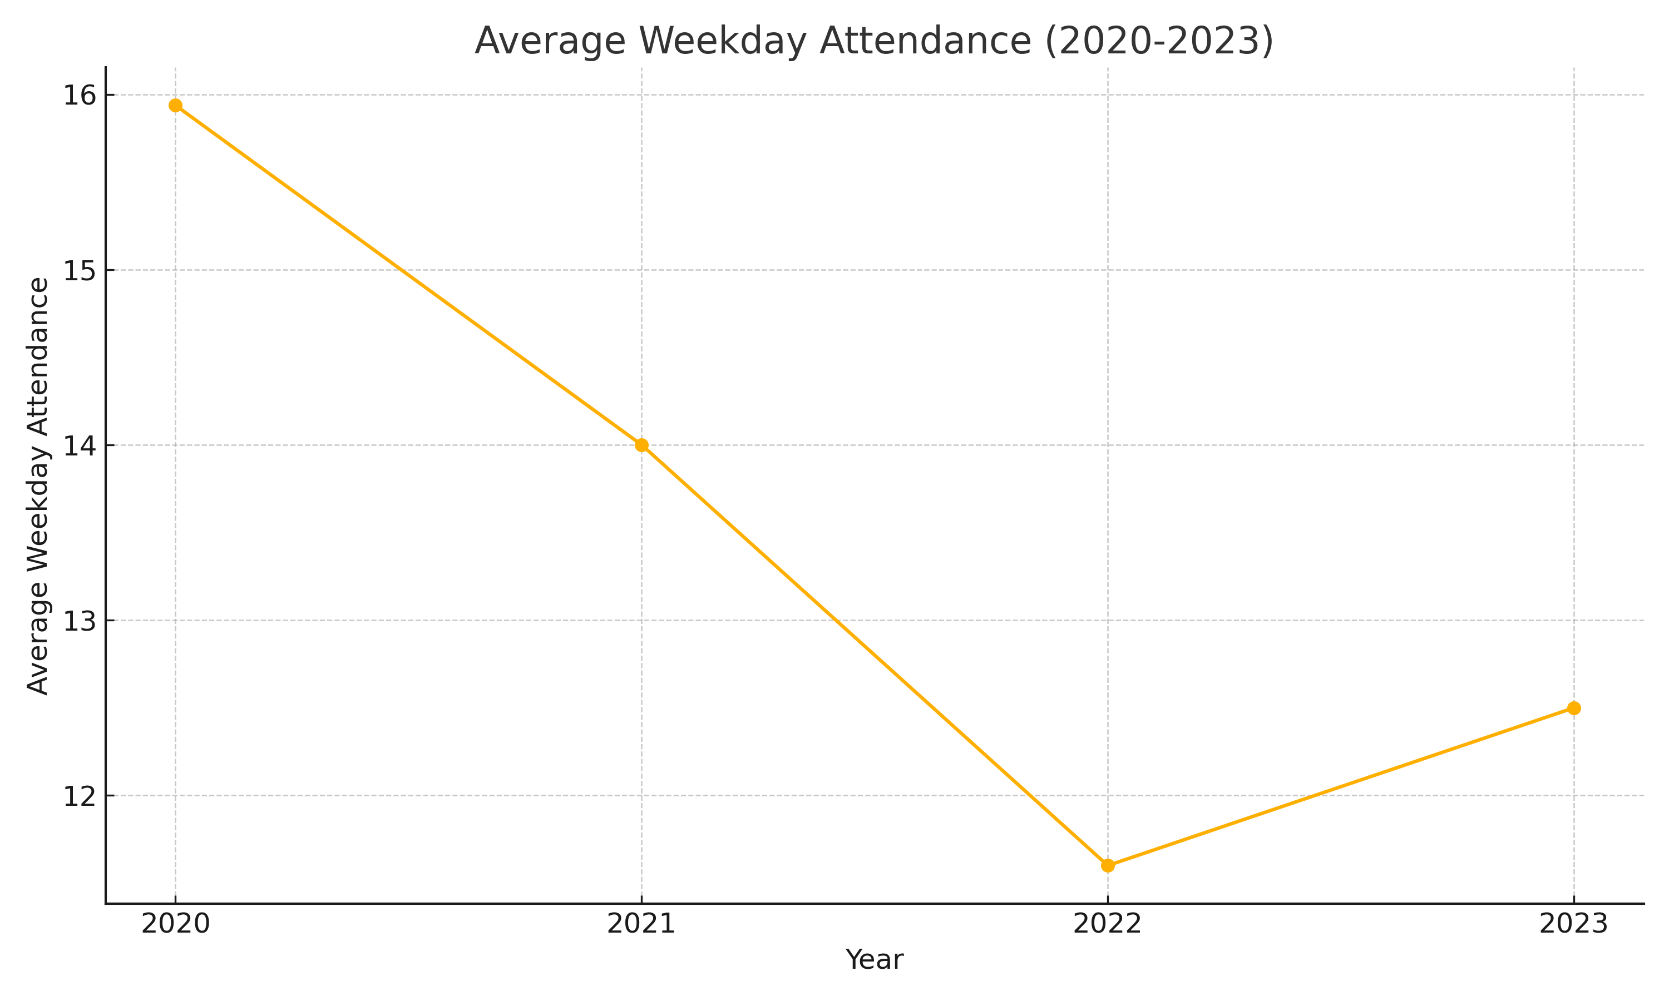
Average attendance at services held on a weekday.
Missing data for 2 parishes.

Slide 13
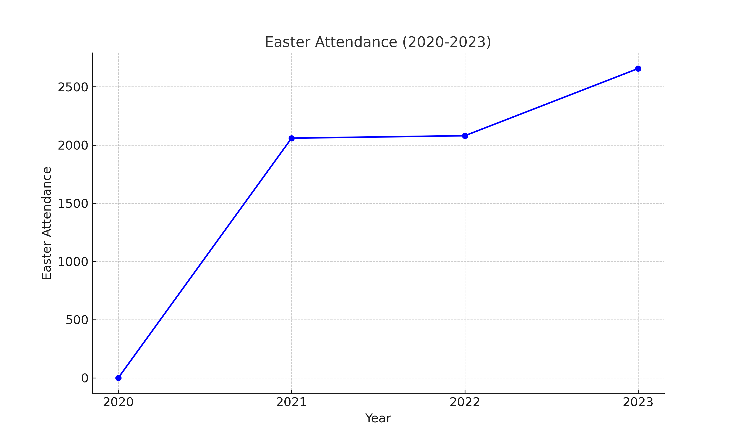
Attendance at all services in the Diocese on Easter Eve & Easter Day.
Missing data from 2 parishes.

Slide 14
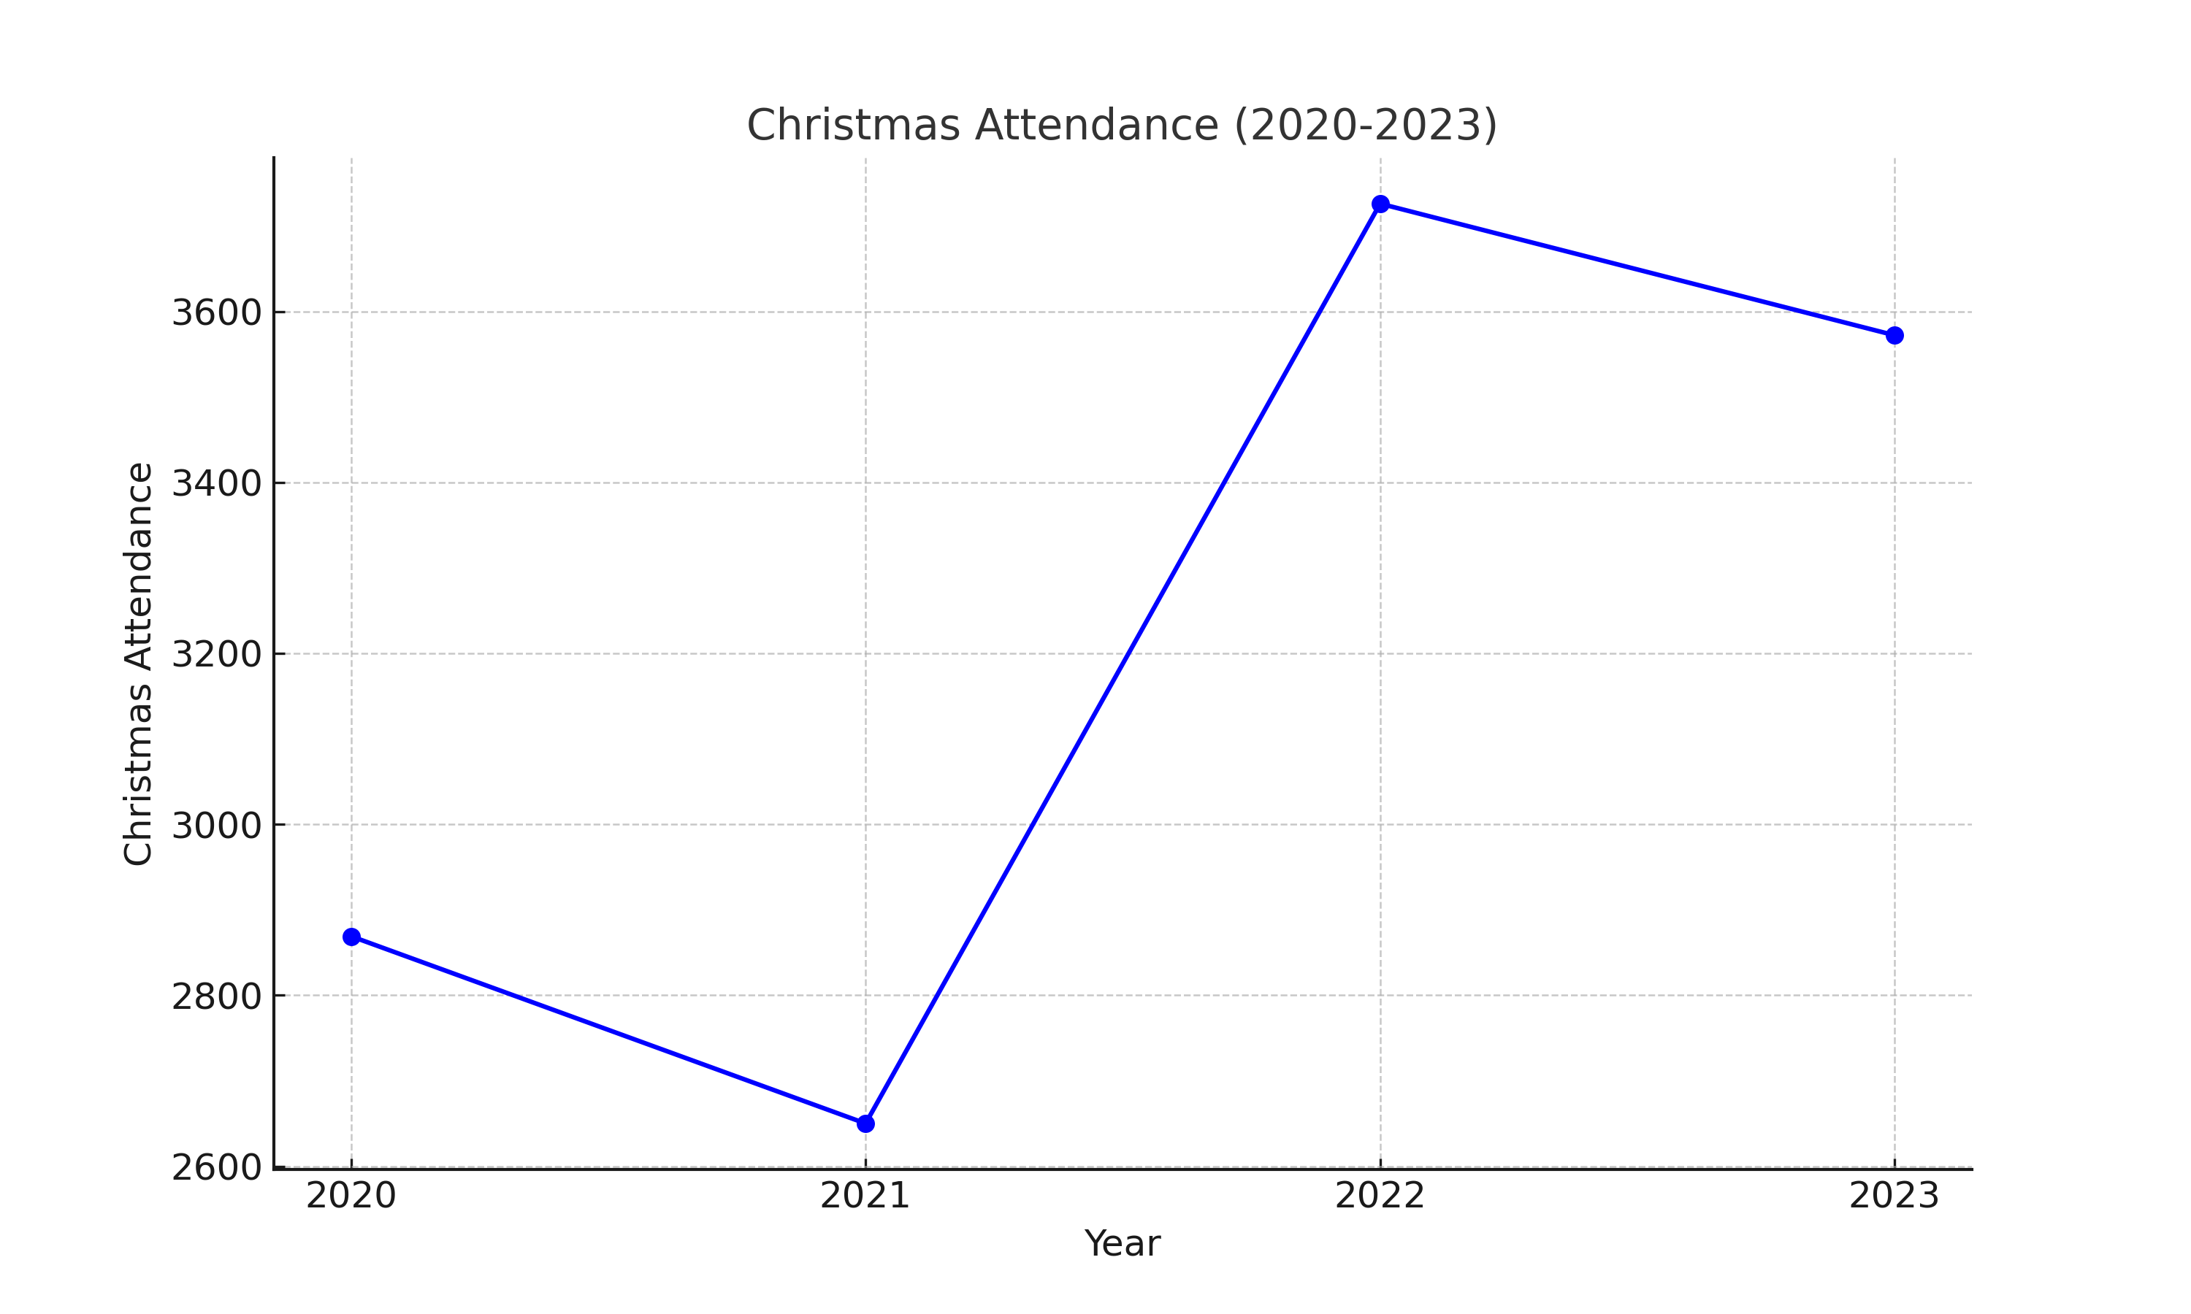
Attendance at all services in the Diocese on Christmas Eve & Christmas Day.
Trendline has been affected by missing data from 2 parishes.

Slide 15
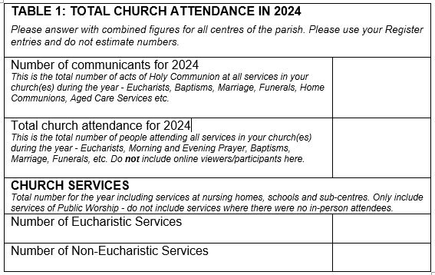

Slide 16
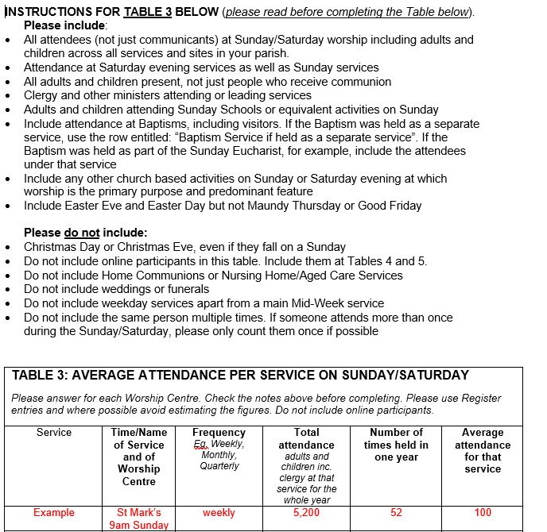

Slide 17

Conclusions
We should be encouraged by a gradual increase in church attendance post-pandemic
2023 saw the highest attendance, indicating a return to or even surpassing pre-pandemic levels
Ministry Units have used missional opportunities (such as those offered by the restructure of worship centres) to try new things and to grow and have also shown resilience and adaptability in challenging times
The collection of more detailed attendance figures is allowing us to track trends in church attendance

Slide 18
