Slide 1
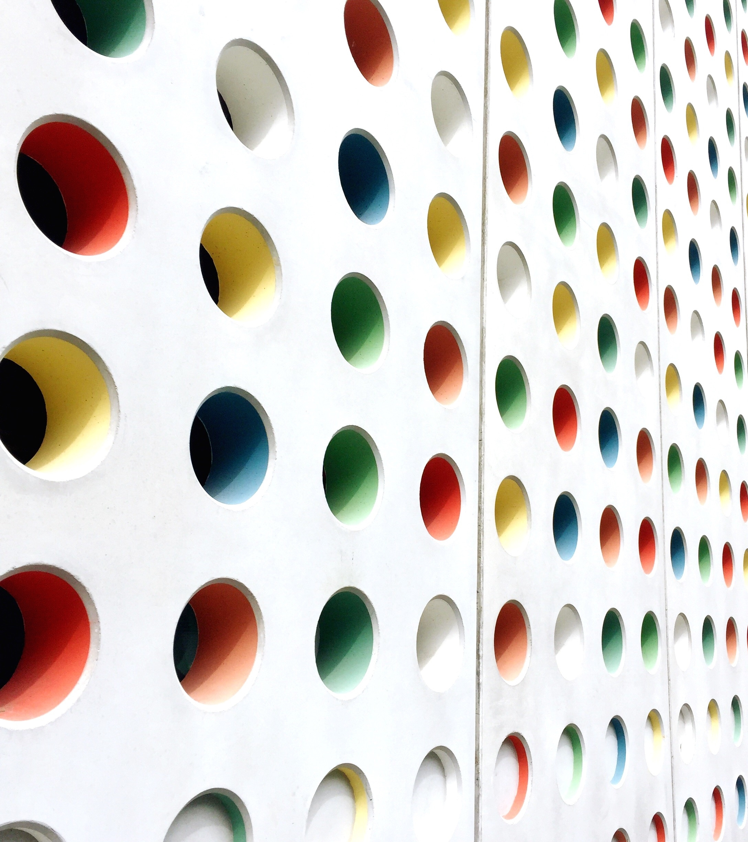
Diocese of Grafton
Church Attendance returns
National Church life survey
Australian census
What can we learn?

Slide 2
2022 SYNOD R33/22: National Church Life Survey
That in 2021 and 2022 the anglican diocese of grafton participated in the national church life survey and parishes were encouraged to participate in the leadership survey, census and church attender survey which provide information to equip the diocese and each parish with data and insights about the current context and trends.
This synod thanks all parishes who participated in the 2021/2022 national church life survey and requests bishop-in-council to form a working group of relevantly skilled people to analyse the data and insights gained from the survey together with relevant church attendance data from parish annual returns.

Slide 3
> Annual returns
Since 2020 – collection of more descriptive church attendance data
> National Church life survey 2021/2022
Insights about those attending our churches, their characteristics and attitudes
> Australian census 2021
Population demographics of our local areas

Slide 4
Sources
Annual Returns of the Diocese of Grafton 2019-2022
Denominational Church Life Profile: Diocese of Grafton 2023. National Church Life Survey Research
Census material: Census Anglicans in Australia, Colin Reilley 2022 and @AustralianAnglican Twitter Account

Slide 5
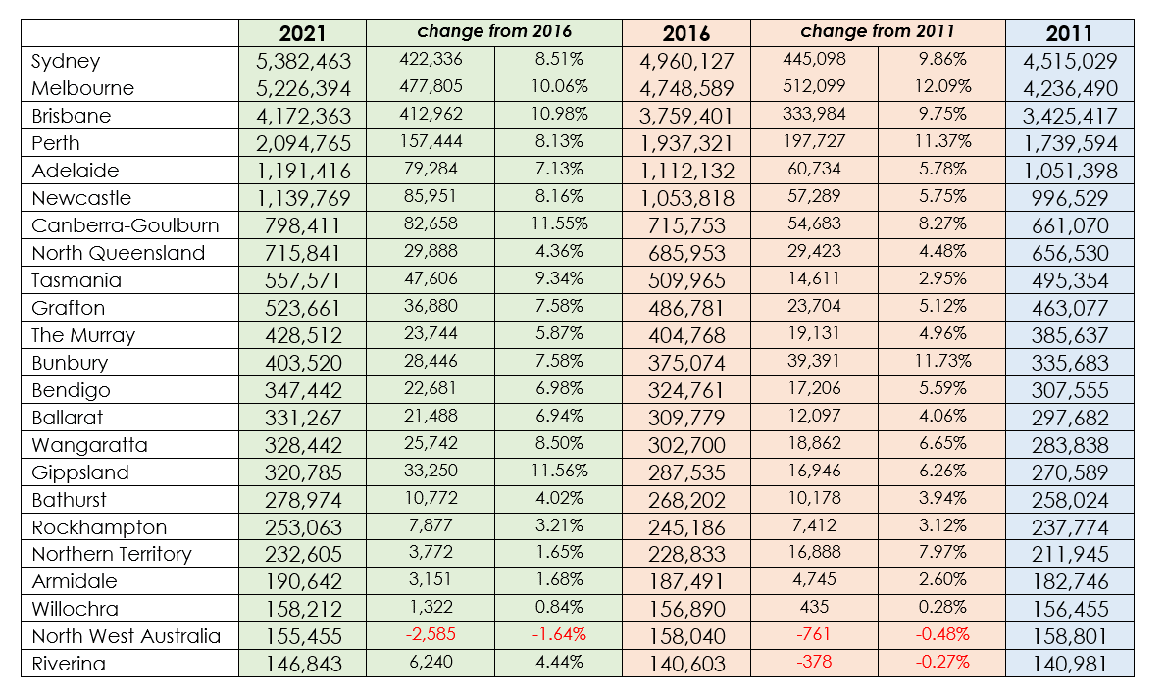

Slide 7
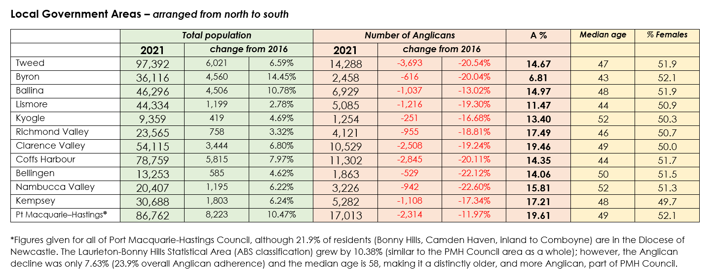

Slide 8
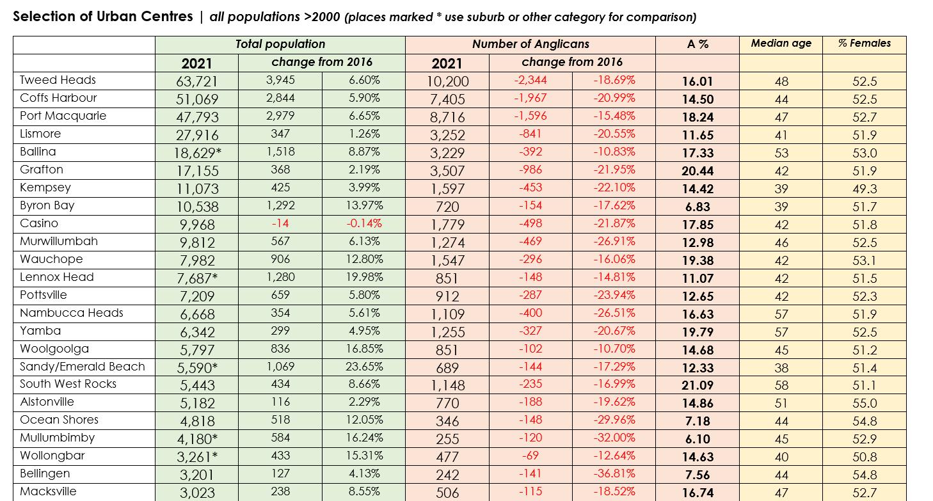

Slide 10
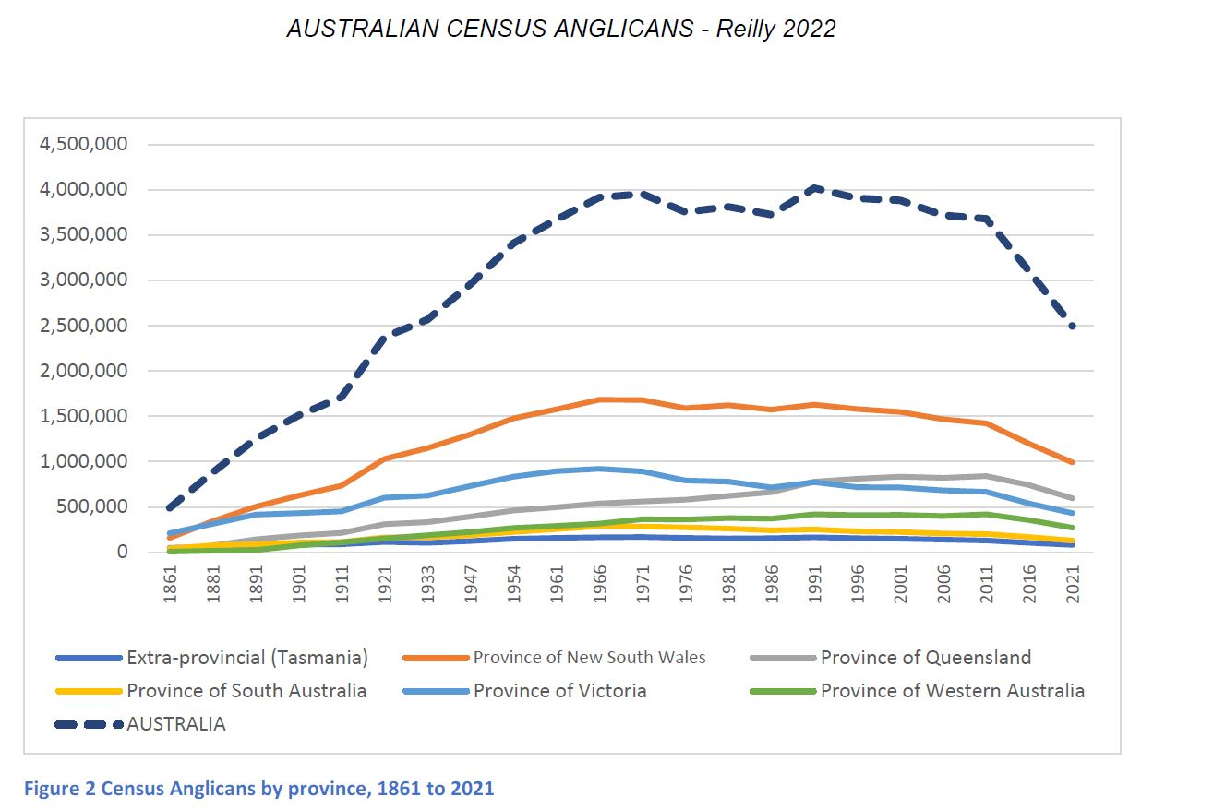

Slide 12
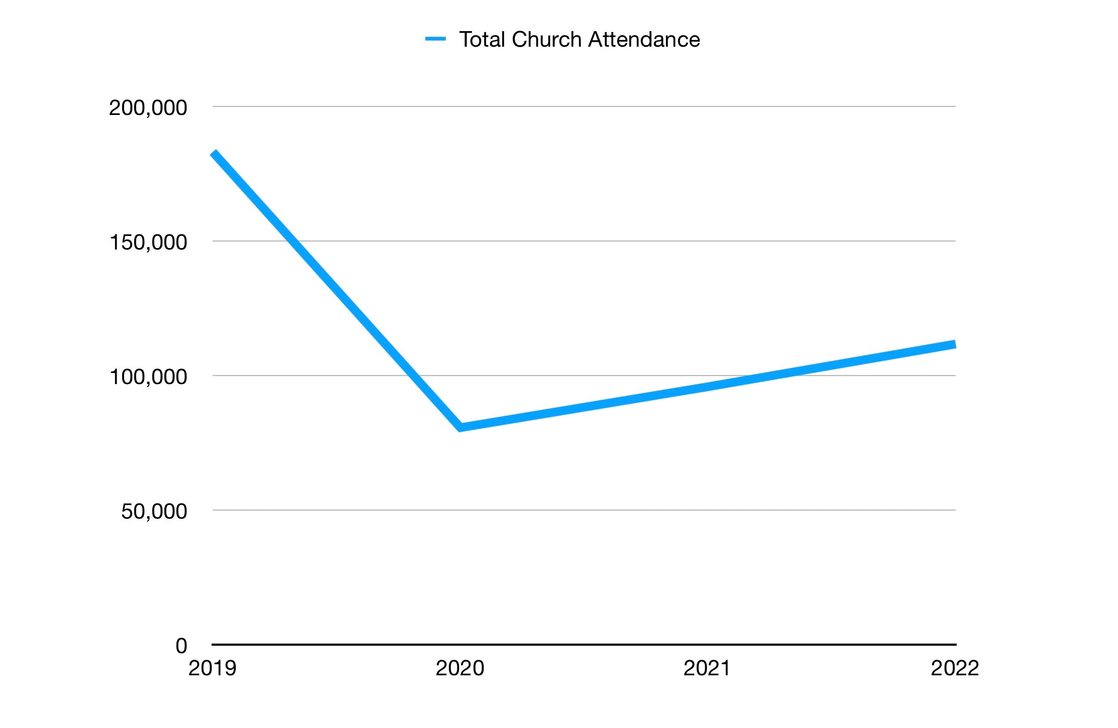
Total Church Attendance in Grafton Diocese each year 2019-2022
Includes attendance at all services of worship in the parish.
Attendance at School services is only included if held on a Sunday eg Lindisfarne & SCAS Chapels.
2019: 181,121
2020: 80,644
2021: 95,869
2022: 111,737
This figure in the Annual Returns form does not include online attendance.

Slide 13
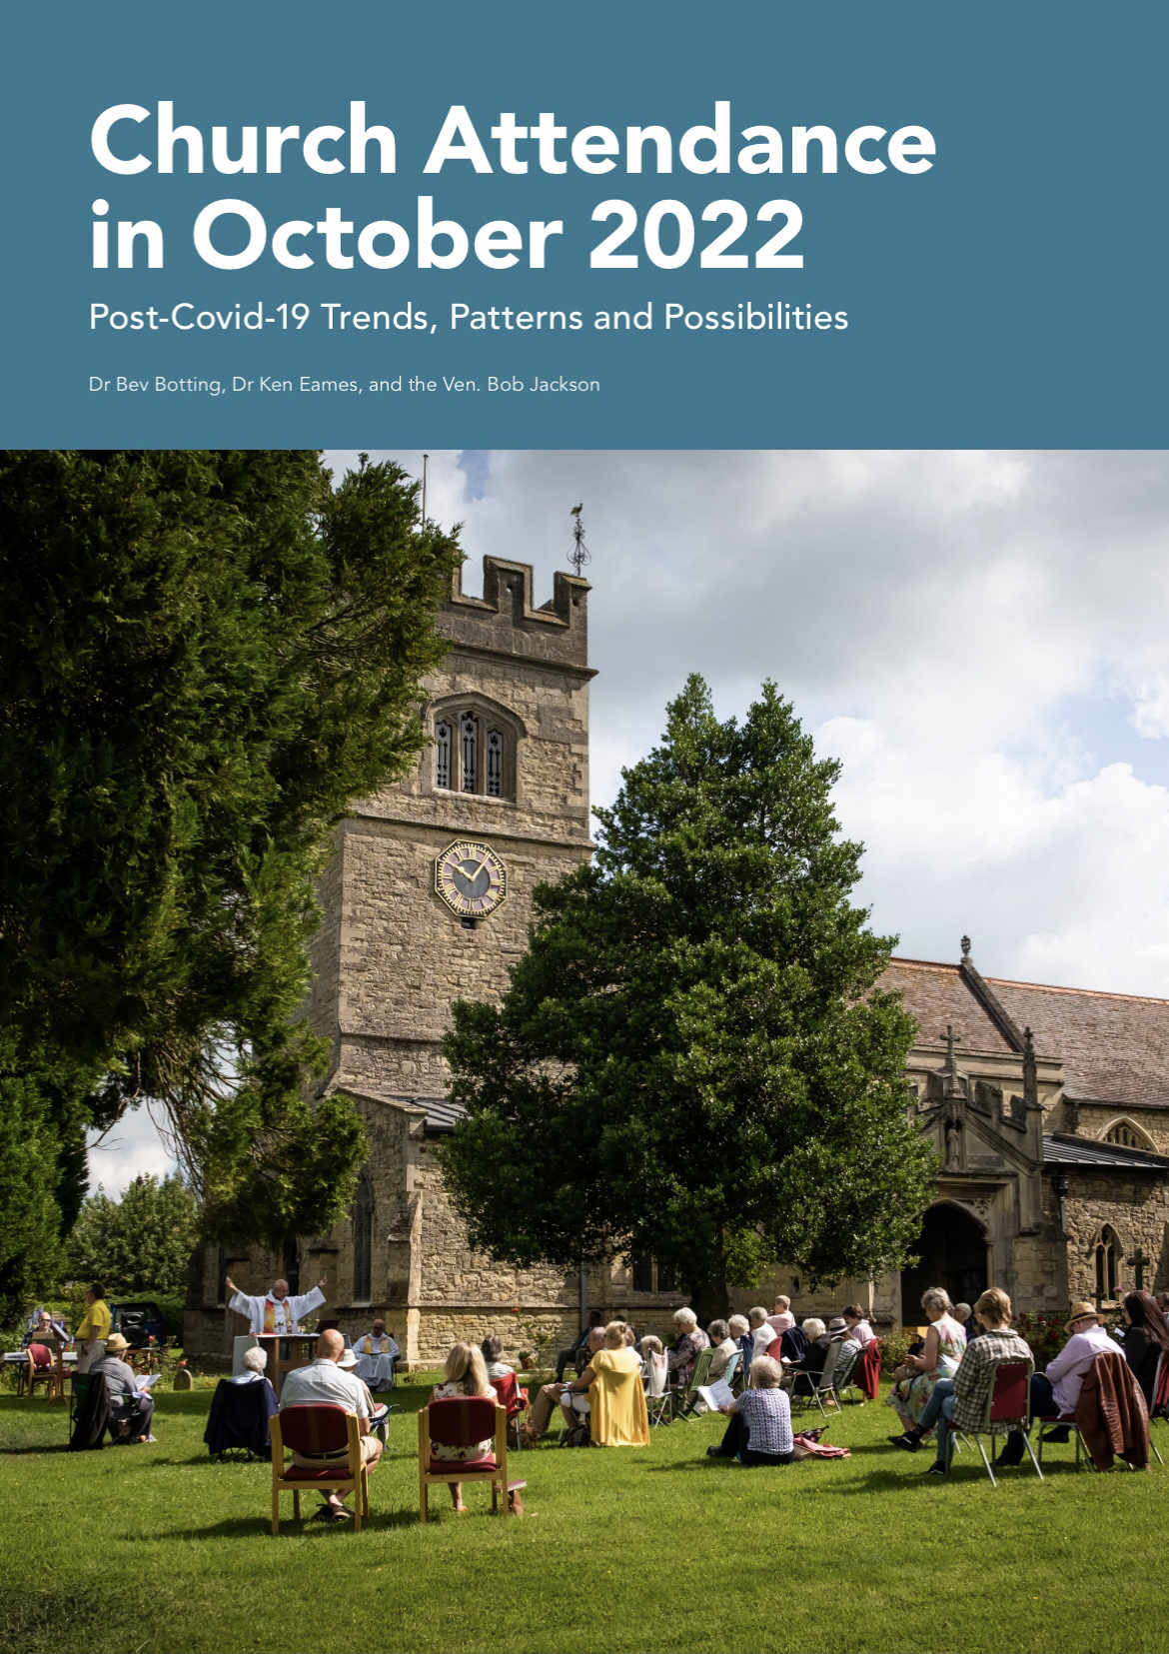

Slide 14
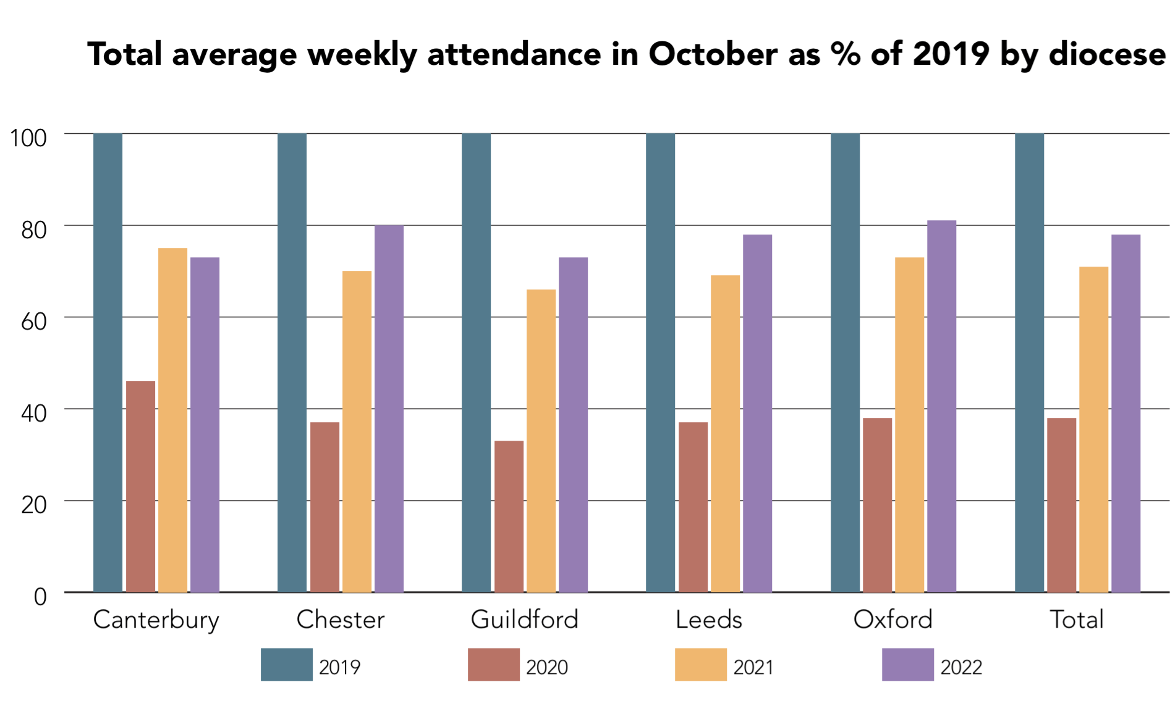

Slide 15
Future data analysis from the Annual Returns
Average Sunday Attendance
Average Weekday Attendance
Attendance at outcentres Weekly, Fortnightly, Monthly
Online Participation
Easter and Christmas Attendance trends
Numbers of Baptisms, Weddings, Funerals
Number of Admissions to Holy Communion, Receptions and Confirmations

