Slide 1
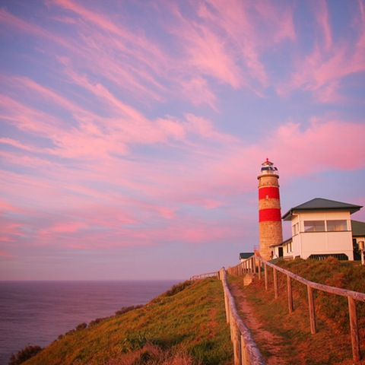
Lord, you call us to be story-tellers:
planting your explosive news into our defended lives;
locating us in the script of your human history.
You call us to be trailblazers:
living in your future that we receive only as gift;
subverting the fixed, fated world of low horizons.
You call us to be weavers:
tracing, stretching, connecting the knotted threads;
gathering up unravelling, disconnected lives.

Slide 2
You call us to be fools – for Christ’s sake:
bearing life’s absurdities and incongruities;
puncturing our seriousness and grandiosity.
You call us to be hosts: welcomers of the sacred, intimate, transfiguring; lavish celebrants of our communities and homecomings.
You call us to be poets: artists and illuminators of inner space;
naming, invoking, heralding your presence.
You call us to be gardeners: sowers, cultivators, nurturers of fragile lives; benefactors of your gratuitous harvest.

Slide 3
You call us to be conductors
celebrating harmony, coaxing symphony;
orchestrating the praise of your inhabited creation;
Lord, you lavish gifts on all whom you call.
Strengthen and sustain us and all ministers of your church,
that in the range and diversity of our vocation,
we may be catalysts of your kingdom in the world,
through Jesus Christ our Lord. Amen
Roger Spiller (1944– ) alt.

Slide 4
Shape me for your service: pin back my arms
that I might proclaim freedom to a captive world.
Teach me by your wisdom: unfold your word
that I might share truth with a hungry people.
Hold me in your love: nurse my need
that I might tender healing for a broken body.
Jane Tillier (1959 - )

