Slide 1
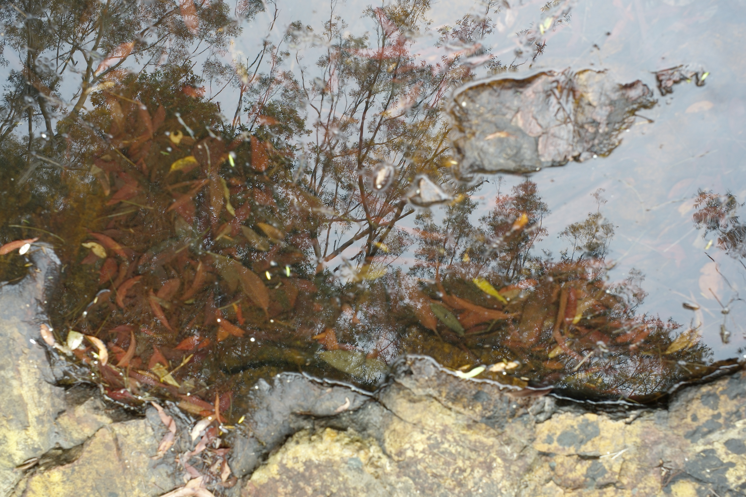
Prevention, Response, recovery
What enables people and parishes to recover from the trauma of abuse?

Slide 2
Professional standards committee
Mr Peter Barnett, Professional standards Director, Dioceses of Armidale and Canberra & Goulburn
Members
Ms heather McKinnon
Canon John Bryen
the Rev'd Lyndon Mulholland,
the Rev'd Ron Miller and
Dr Liz Reimer

Slide 3
context
Report – child Sexual Abuse in the Anglican Church (Parkinson, Oates & Jayakody 2009)
  1990-2008 – 191 cases (17 diocese)
  75% complainants were male 10 to 15 at the time of the abuse
  Accused were clergy and/ or voluntary or paid youth work
  Long delays in reporting
  50%+ substantiated/ 33% inconclusive
January 2013 to December 2017 - Royal commission into institutional responses to child sexual abuse http://childabuseroyalcommission.gov.au/

Slide 4
How might we makes sense of abuse in Religious institutions?
Theological
…
Psychological
Attachment Theory
Sociological
Institutions (Goffman)
Mores and Norms
Legal
Child Protection
Domestic and Family Violence
Managerial
Professional Standards Board/ Committee
Ordinances

Slide 5
Ordinances and protocols
Professional standards ordinance 2004 (as amended 2017)
Protocol for dealing with complaints of sexual abuse (2004)
  Professional standards committee
  Director of Professional standards (Mr Peter Barnett)

Slide 6
Creating a safe space
1 in 3 women have been assaulted – this is us …
What do I need to feel safe?

Slide 7
prevention
Institutional culture
  Faithfulness in service
  Employment screening
Early intervention - grooming

Slide 8
Case study - LLM
You are the LLM and Father Luke, the parish priest. Father Luke is aged around 40 and lives in the manse beside the church. He is married to Sonya. Sonya works in a bank in the next town.
John and Martha Turner live in your parish. John is a long distance truck driver. Martha volunteers in your local parish Op Shop. Martha is Filipina. She and John have been married for 15 years and they have one son, Ben (12). Ben attends the local school. Martha’s family were catholic however Father Luke was very friendly when she met him at a school function and she now attends the Anglican services. Martha’s English is limited and she rarely joins in the op shop conversations. Nevertheless, she works hard, is reliable and can always be called upon to fill in for others. She is proud of her contribution. This volunteering is the only activity that she pursues outside of the home.
Ben often meets his mother to the Op Shop. The Op Shop is located beside the church and the manse. The Parish priest, Father Luke, regularly invites Ben into his home for a cold drink. Unlike his father, they (Ben and the parish priest) talk with each other on FaceBook and play chess together on the internet. They make chess moves several times a day. Ben admires Father Luke. While Martha appreciates the special attention Father Luke gives her son, John has started to question why his son has been singled out in this way.

Slide 9
Case study – Ministry School
Peter, the LLM is married to Sonya and has no children. Peter is very devoted. He is at The Op Shop and church grounds throughout the week.
John and Martha Turner live in your parish. John is a long distance truck driver. Martha volunteers in your local parish Op Shop. Martha is Filipina. She and John have been married for 15 years and they have one son, Ben (12). Ben attends the local school. Martha’s family were catholic however the LLM, Peter, was very friendly when she met him at a school function and she now attends the Anglican services. Martha’s English is limited and she rarely joins in the op shop conversations. Nevertheless, she works hard, is reliable and can always be called upon to fill in for others. She is proud of her contribution. This volunteering is the only activity that she pursues outside of the home.
Ben often meets his mother to the Op Shop. it is located beside the church and the manse. Peter regularly invites Ben to help him with the garden and to have a private cold drink in the church hall. Unlike his father, they (Ben and peter) talk with each other on FaceBook and play chess together on the internet. They make chess moves several times a day. Ben admires peter. While Martha appreciates the special attention peter gives her son, John has started to question why his son has been singled out in this way.

Slide 10
Question
What might you be thinking about/ what questions would you ask, (from your group’s perspective), if you were trying to make sense of what was going on?

Slide 11
Question
As the parish priest, how might you respond?

Slide 12
Question
• If you were peter and John questioned your motives with his son, how would you feel? How might you respond?

Slide 13
Case study
Simon, a 40 year old man, starts coming to church regularly. He has recently moved to the area and is initially a vague historian. He is quite reclusive. Once he starts to talk about his family he invites you, the LLM, to stand with him against the injustices of the family law system against men. His wife has turned his children against him. His daughters made up stories about him under the influence of his wife. She has mental health problems and is paranoid. He is completely misunderstood. They lied and he can’t see his children. He wants you to help him to contact his 2 daughters – aged 12 and 14. They need the support of their father.

Slide 14
Case study
.. He is a photographic artist. He appreciates the beauty of young women. He enjoyed working with his daughters’ friends. They enjoyed dressing up and having their photo taken by him.

Slide 15
Case study 3
Mary, a 32 year old single woman attended All Souls, Bangalow when she joined the Buttery program 2 years ago. She has progressed through the program and now lives in the local community (away from Bangalow) and attends church regularly. She works part-time as a teacher’s aide. As she enjoys gardening and lives in a flat, You welcomed her proposal to look after the church garden on a voluntary basis. The church is adjacent to the manse and Mary gardens 3 days per week. You enjoy sharing a cup of tea with Mary when she finishes the gardening. You became friends and confidantes. you shared your dreams for the parish with her and she shared her dreams for the garden. When Mary was anxious about attending a family wedding, as there would be alcohol and tricky family dynamics, you accepted her invitation to accompany her. The wedding was a success. you supported her through the family questions and comments. However, when Mary invited you to her home for dinner, you declined. Mary was devastated and embarrassed. you had often embraced Mary and Mary thought that the feelings of closeness had been mutual. Mary confides in you, and others in the parish, that she can’t continue being involved as she feels she has been misled and is deeply hurt and embarrassed.
Mary explains her position to as many people as possible, gathering their support. Some people take her side, others take yours…

Slide 16
recovery
Creating safe spaces
Split communities - Belief/ disbelief
Recovery processes

Slide 17
response
Acknowledge/ believe
procedures

Slide 18
recovery
Creating safe spaces
Split communities - Belief/ disbelief
Recovery processes

